Slide 1


SMART DEFEND : STRENGTHENING IOT SECURITY WITH ADVANCED MACHINE LEARNING TECHNIQUES.
Presented by :-
Joyline Rencita Dsouza 4SO20CS073
Melanie Crystal Miranda 4SO20CS085
Natasha Elizabeth Correia 4SO20CS092
Under the Guidance of:-
Dr Saumya Y M
Associate Professor,
Dept Of Computer Science, SJEC

Slide 2

ABSTRACT
With the advancement of internet technology, the number of threats are also rising exponentially,
To reduce the impact of these threats, researchers have proposed many solutions for intrusion detection.
In the literature, various machine learning classifiers are trained on older datasets for intrusion detection which limits their detection accuracy.
So there is a need to train the machine learning classifiers on the latest dataset.
In this project, UNSW-NB15 , the latest dataset is used to train machine learning classifiers.

Slide 3
Introduction
As the widespread adoption of IoT continues to grow, its integration into various sectors results in the generation, processing, and transmission of large amounts of data.
With the increasing use of IoT, the threats to IoT networks are increasing day by day, posing challenges to their security.
To address these threats and risks effectively, we require a strong and robust approach to ensure the security of IoT networks.
As the Internet of Things (IoT) continues to grow, the security of IoT devices becomes paramount. The challenge at hand is to design and implement a robust machine learning-based intrusion detection system specifically tailored for IoT devices. The goal is not only to detect anomalous activities but also to classify these intrusions into specific types of attacks, providing a comprehensive security solution for the diverse and resource-constrained IoT ecosystem.

Slide 4
Problem Statement
Given a network traffic dataset, develop a machine learning model that can accurately classify each network connection as either normal or malicious. The model should be able to identify different types of attacks, such as Fuzzers, Reconnaissance, Shellcode, Analysis, Backdoors, DoS, Worms, Generic, Exploits.
The project also emphasizes user accessibility by integrating a user-friendly interface or dashboard, facilitating seamless interpretation of detected anomalies and attack classifications

Slide 5
DATASET : UNSW-NB15
UNSW-NB 15 data set was created in the Cyber Range Lab of the Australian Centre for Cyber Security (ACCS) by the IXIA Perfect Storm tool.
This dataset contains a hybrid of normal activities and attack behaviors. Tcp-dump tool was used to capture 100 GB of the raw traﬃc.
Twelve algorithms and tools such as Argus, Bro-IDS were used to generate UNSW-NB15. It contains 49 features including a class label
This dataset contains the recent intrusion attacks and their feature sets in a labeled manner, which accurately trains the model. The feature sets extracted and stored in a separate file “UNSW-NB15 features.csv”.
The dataset contains almost 2,000,000 records of intrusion behaviors with their parameters labeled in a particular class. Hence, this dataset selected for training our model using the best-suited algorithm.

Slide 6
DATASET : UNSW-NB15
16. Dload
17. Spkts
18. Dpkts
19. swin
20. dwin
21. stcpb
22. dtcpb
23. smeans
24. dmeans
25. trans_depth
26. res_bdy_len
27 Sjit
28 Djit
29 Stime
30 Ltime
Columns of the existing dataset:
srcip
sport
dstip
dsport
proto
state
dur
sbytes
dbytes
sttl
dttl
sloss
dloss
service
Sload
31.Sintpkt
32. Dintpkt
33. tcprtt
34. synack
35. ackdat
36. is_sm_ips_ports
37. ct_state_ttl
38. ct_flwh_ttp_mthd
39. is_ftp_login
40. ct_ftp_cmd
41. ct_srv_src
42. ct_srv_dst
43. ct_dst_ltm
44. ct_src_ltm
45. ct_src_dport_ltm
46. ct_dst_sport_ltm
47. ct_dst_src_ltm
48. attack_cat
49. Label

Slide 7
DATA DESCRIPTION
The dataset comprises 49 features representing 9 attack categories, including Analysis, Fuzzers, Backdoors, DoS, Exploits, Reconnaissance, Generic, Shellcode, and Worms.
Features type of UNSW-NB15 dataset:
SNo. Feature Type Count
1 Nominal 6
2 Integer 28
3 Binary 3
4 Float 10
5 Timestamp 2
Details of events in UNSW-NB15 dataset:
Name Count
Total Number of events 2540044
Normal 2218761
Attacks 321283
The attributes are mixed in nature with some being nominal, some being numeric and some taking on time-stamp values.
This dataset contains a total of 25,40,044 labelled instances, each being labelled either normal or attack. The distribution of connections across the two groups is presented

Slide 8
Literature Survey

Slide 9
Research Papers
1.Detecting Cybersecurity Attacks in Internet of Things Using Artificial Intelligence Methods
Problems Addressed:
Vulnerabilities of IoT networks to malicious attacks across various domains
Techniques Used:
SVM, SVR, DT, RF, NB, LR, KNN, fuzzy algorithms
Implementation and Results:
ML methods like RF and DNN enhance anomaly detection.
Limitations/ Future Scope:
To achieve better performance, combine multiple models to obtain high accuracy

Slide 10
2. A Novel Feature Selection Approach to Classify Intrusion Attacks in Network Communications
Problem addressed: the inadequacy of traditional intrusion detection systems (IDSs) in effectively detecting sophisticated cyber attacks from normal network traffic, necessitating the development of new techniques that leverage data mining, machine learning for distinguishing intrusions.
Methodology: involves proposing the FSACM for dynamic attack determination in WLANs, comprising a feature selection process using FSAP and a hybrid attack detection model (SABADT).
The FSAP approach employs a new algorithm to reduce features further based on homogeneity conditions. The SABADT technique, a fusion of signature and anomaly-based models, enhances intrusion detection speed and accuracy. Signature-based detection relies on predefined rules derived from normal and attack situations, while the anomaly-based model analyzes traffic behaviors to detect unknown attacks.
Results:The proposed method is evaluated on KDD '99 and UNSW-NB15 datasets, outperforming existing machine learning algorithms in terms of detection and efficiency metrics.
Limitations/Future Scope:Enhance algorithmic accuracy.

Slide 11
Design Phase

Slide 12
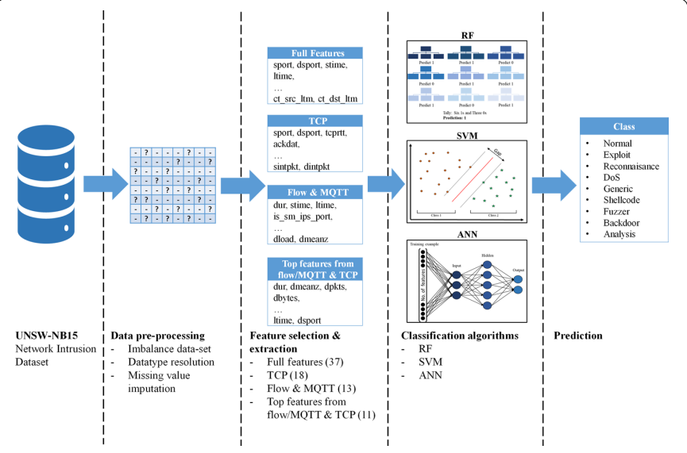
Methodology
Proposed Framework for Intrusion Detection System

Slide 13
Proposed Framework
The UNSW-NB15 dataset is a network traffic dataset that contains a variety of network-based attacks captured in a controlled environment.
It includes features like flow ID, protocol, source and destination IP addresses, source and destination ports, etc.
This dataset is commonly used for intrusion detection and network security research.

Slide 14
Proposed Framework
In Data Analysis we explore the relationship between the features.
Dealing with any missing or null values in the dataset, which could otherwise affect the performance of machine learning algorithms.
Ensuring consistency in data types across different features, converting them into appropriate formats if needed.

Slide 15
Proposed Framework
Using all available features for a complete analysis
Focusing on details related to TCP protocol for deeper insights.
Examining features specific to network flow and MQTT protocol to understand their patterns.
Selecting the most important features from TCP and MQTT data for focused analysis.

Slide 16
Proposed Framework
RF is Machine learning method combining multiple decision trees to improve accuracy and reduce overfitting. Robust, works well with large datasets, provides feature importance measures.
Supervised learning algorithm finding a hyperplane to separate classes in feature space. Effective in high-dimensional spaces, memory-efficient, works well with small to medium-sized datasets.
Computational model inspired by the human brain's neural networks, consisting of interconnected nodes organized in layers. Learns complex patterns, handles large and complex datasets, generalizes well to unseen data.

Slide 17
Proposed Framework
At the final step of the framework, the system aims to classify whether an attack has occurred or not. If an attack is detected, the system proceeds to identify the specific type of attack based on the predefined categories.
If no attack is detected, the system proceeds with the normal state, indicating regular network activity without any malicious behavior.
Here's the list with just the names of the attack categories: Exploit, Reconnaissance, DoS (Denial of Service), Shellcode, Generic, Fuzzer, Backdoor, Analysis,worms

Slide 18
Implementation

Slide 19
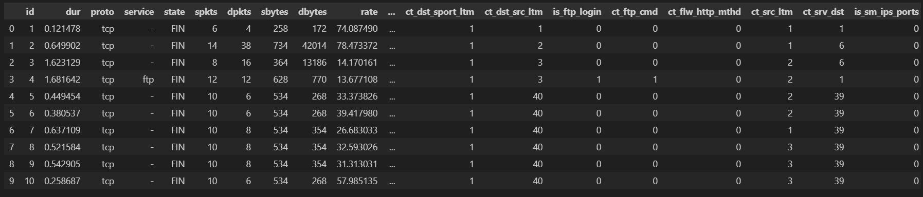
Dataset
This is the initial dataset of our project
Our dataset contains total 1,75341

Slide 20
Dataset

Slide 21
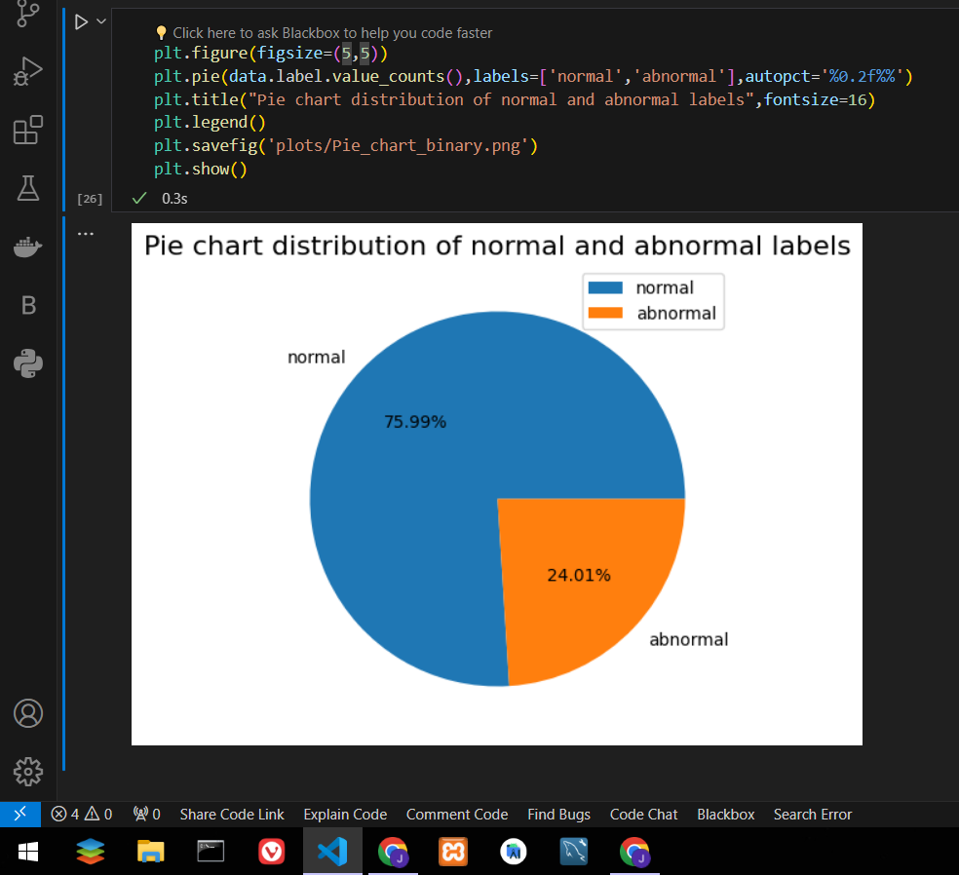
Data Visualisation

Slide 22
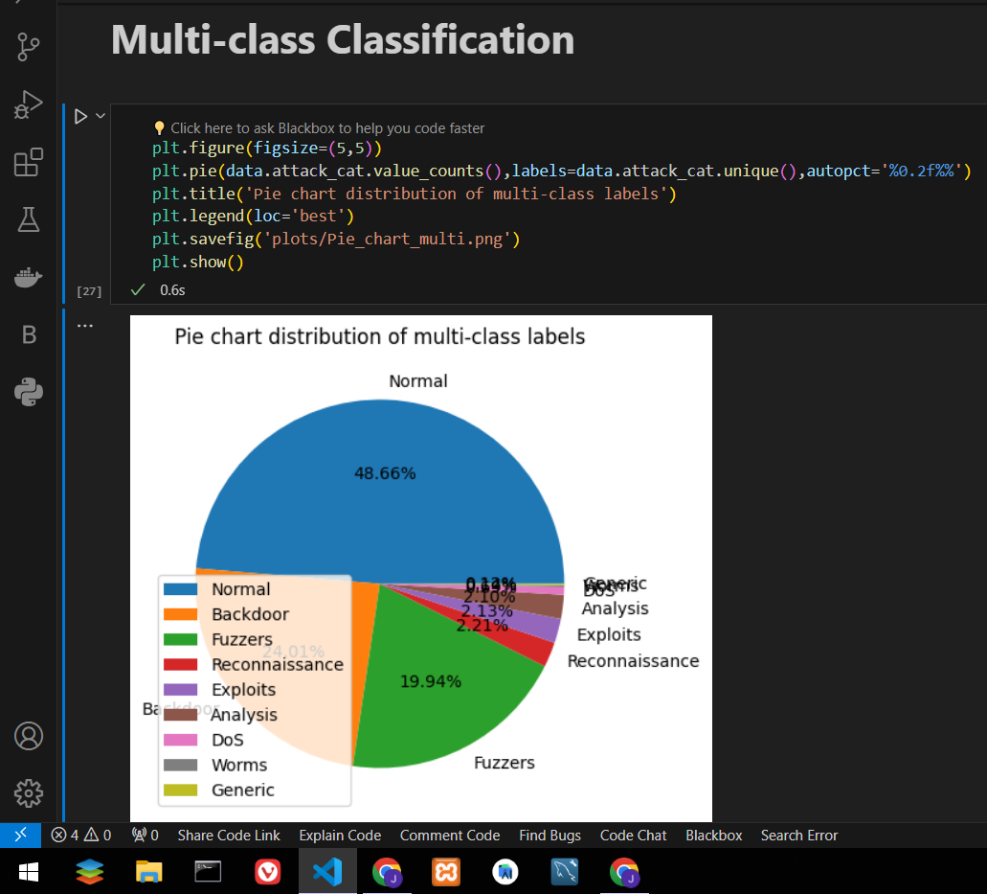
Data Visualisation

Slide 23
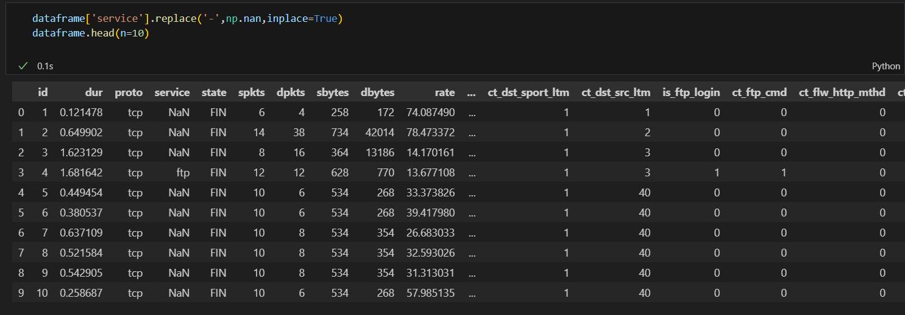
Data Pre-Processing
Replacing the ' - ' with NaN in the service column of the dataset

Slide 24
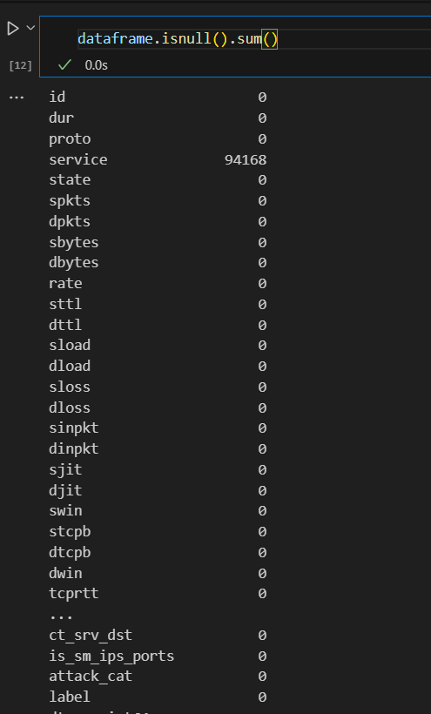
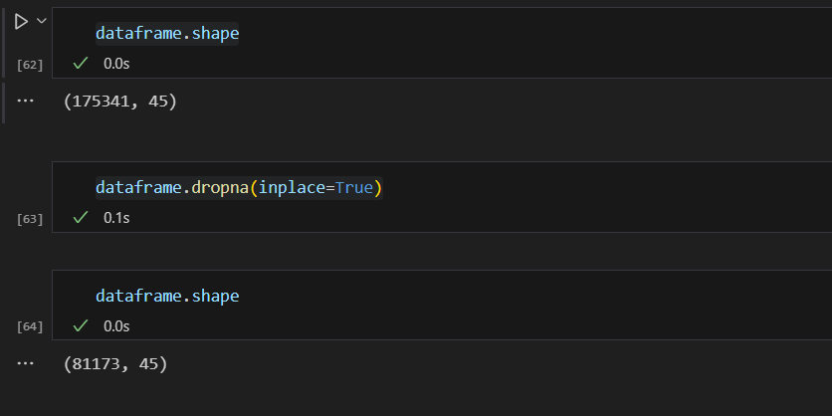
Data Pre-Processing
Dropping the rows which has NaN values in the service column

Slide 25
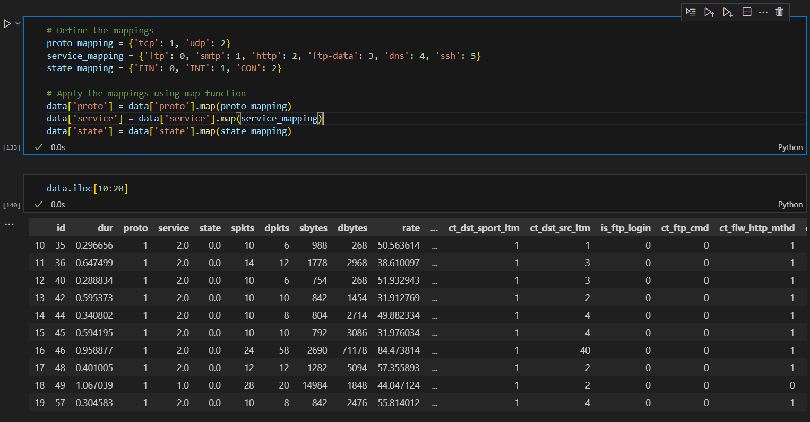
Data Pre-Processing

Slide 26
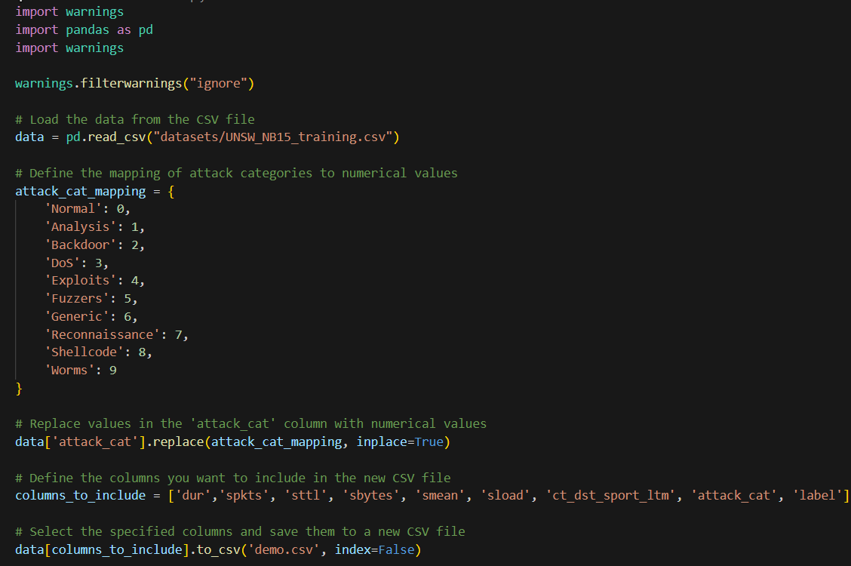
Data Pre-Processing
Label Encoding

Slide 27
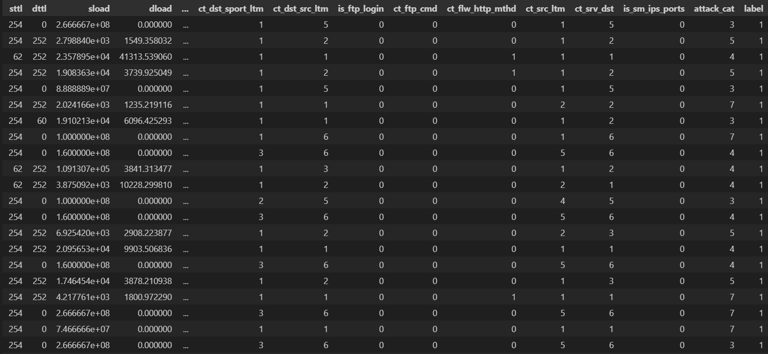
Data Pre-Processing

Slide 28
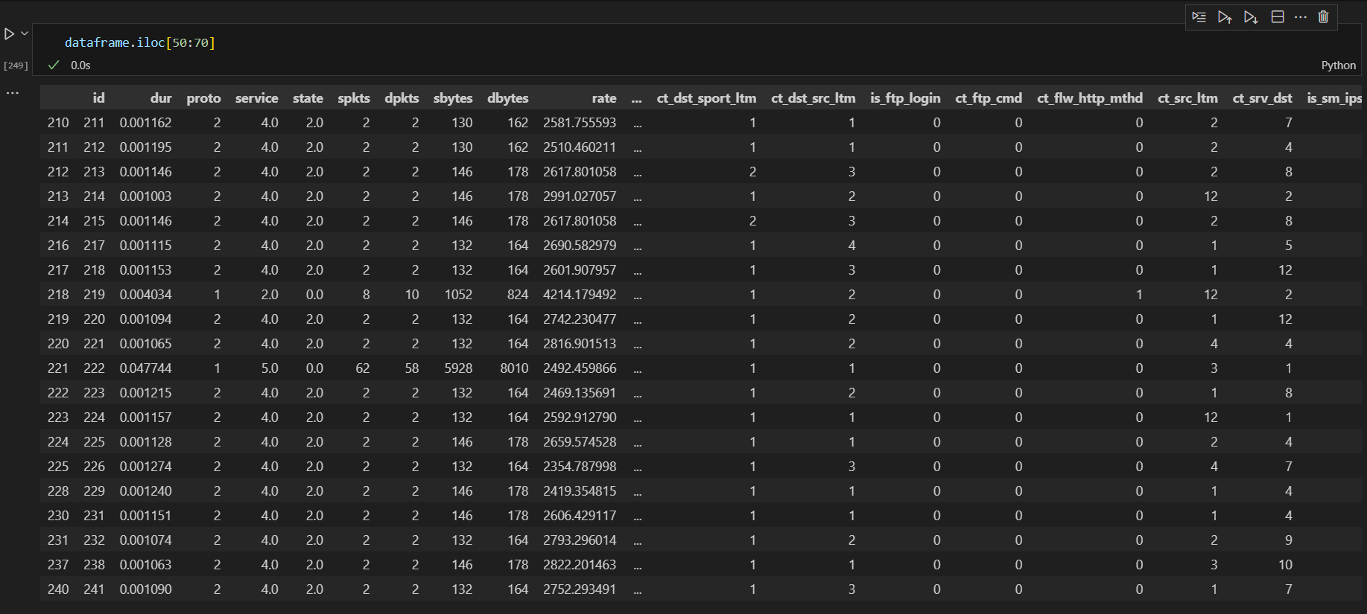
Data Pre-Processing

Slide 29
Feature Selection
“dur” : Record total duration.
“spkts”: Source to destination packet count.
“sttl” : Source to destination time to live value.
“sbytes” : Source to destination transaction bytes
“sload” : Source bits per second.
“smean” : Mean of the flow packet size transmitted by the source.
“ct_dst_sport_ltm” : No. of connections of the same destination address and source port.
“attack_cat” : The name of each attack category.
“label” : 0 for normal and 1 for attack records

Slide 30
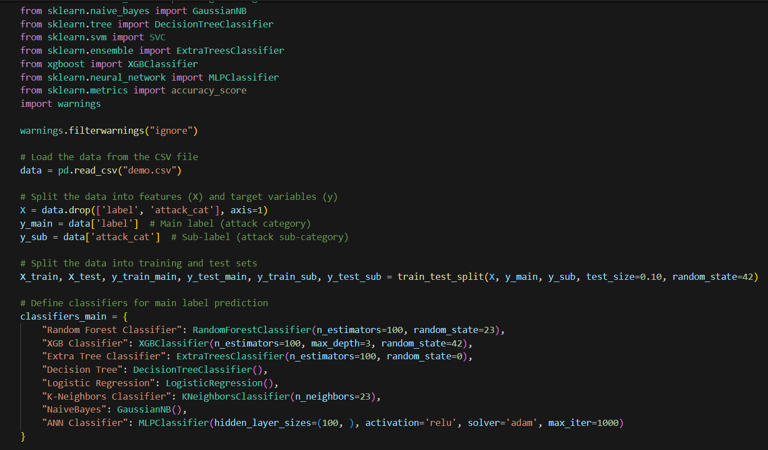
Models : Binary Classification

Slide 31
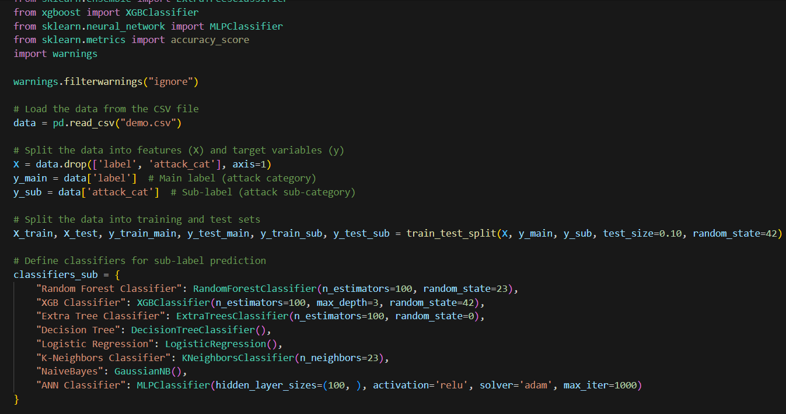
Models : Multi-Class Classification

Slide 32
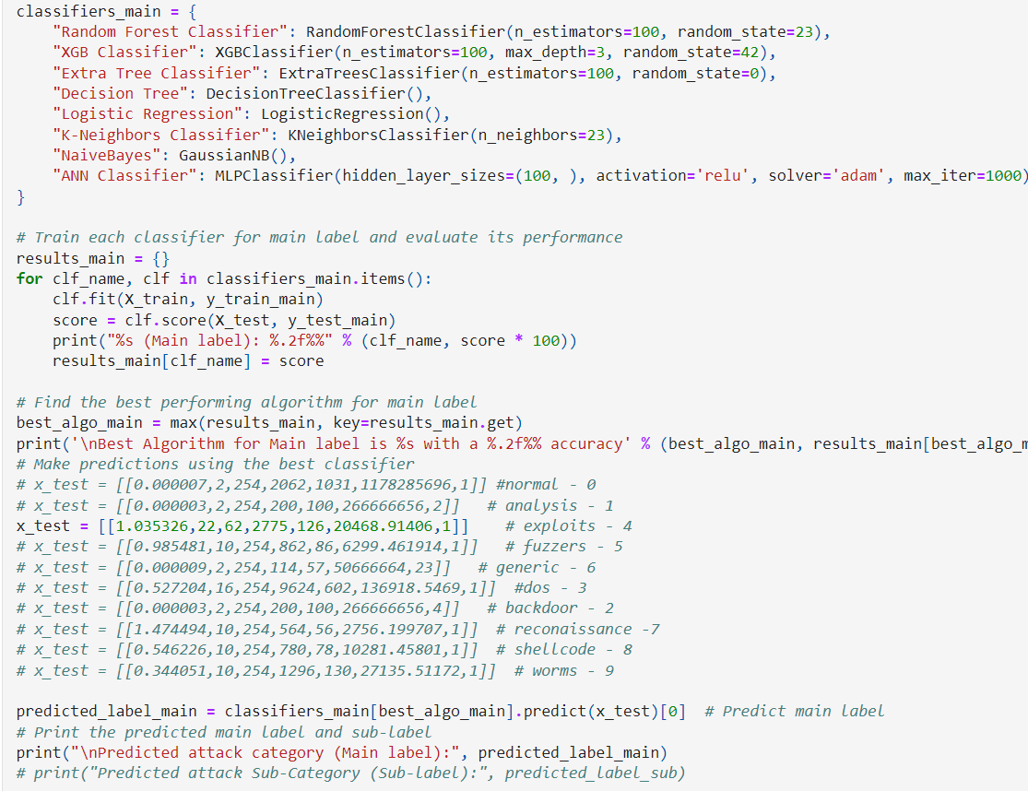
RESULTS : Binary Prediction

Slide 33
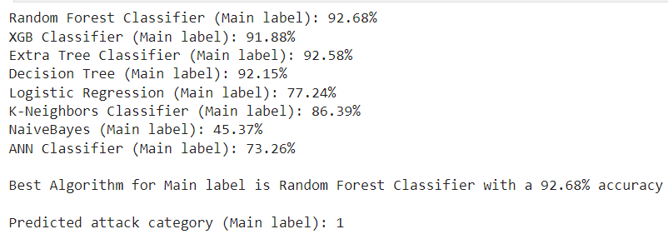
RESULTS : Binary Prediction

Slide 34
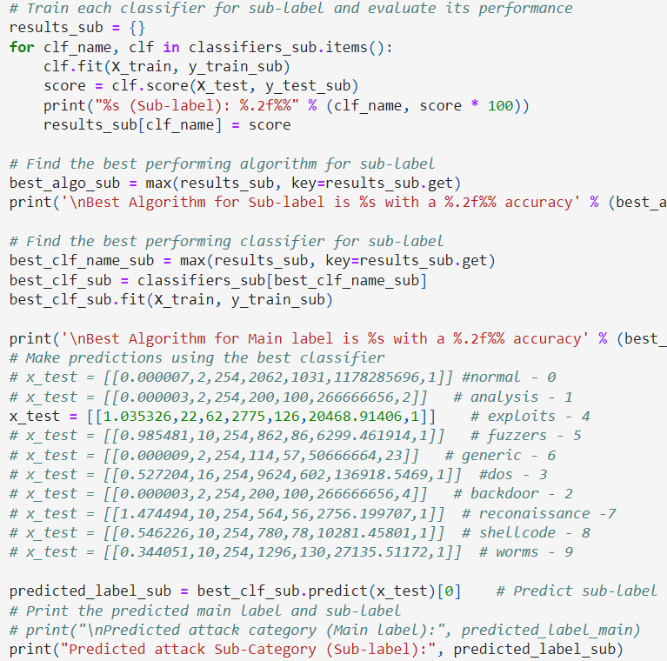
RESULTS : Multiclass Prediction

Slide 35
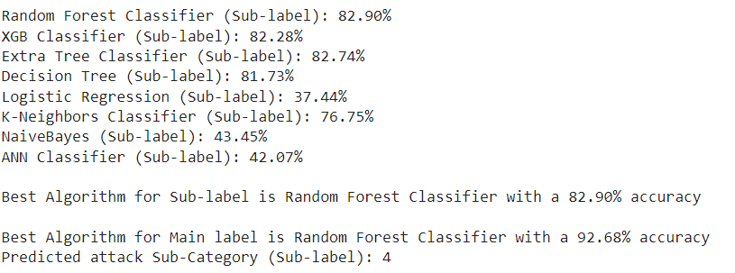
RESULTS : Multiclass Prediction

Slide 36
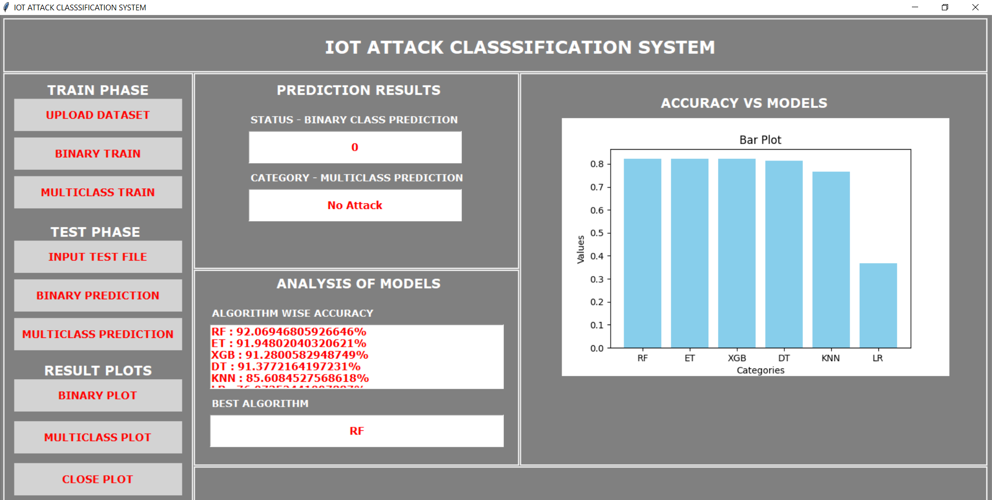
Interface

Slide 37
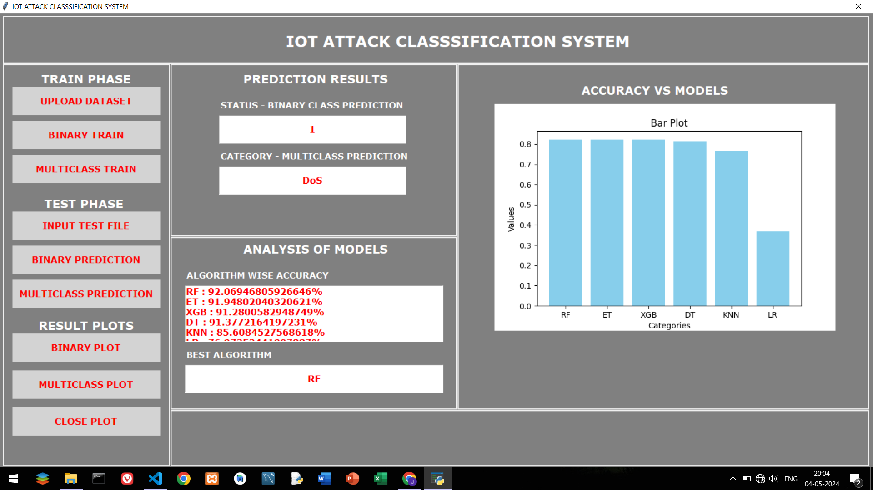
Interface

Slide 38
Conclusion and Future Work
In future we can use real-time data from web scraping and APIs, enabling dynamic threat monitoring and immediate response to emerging security threats.
From safeguarding smart cities to enhancing home security, our solution offers instant intrusion alerts for administrators across diverse IoT environments.
Creating a user-friendly experience, making monitoring and management tasks efficient and hassle-free, in the form of website or mobile application.

Slide 39

﻿THANK YOU

